Slide 1
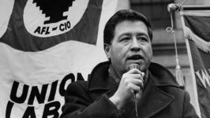

Cesar Chavez
Stories of Excellence
Human Relations, Diversity & Equity
Student Support and Attendance Services

Slide 2
Welcome
Would you rather watch a horror movie or a comedy?
Horror
Comedy

Slide 3
Objectives
Learn about the life of Cesar Chavez
Discuss Cesar Chavez's lasting legacy
Reflect on the ways in which Cesar Chavez's work continues today

Slide 4

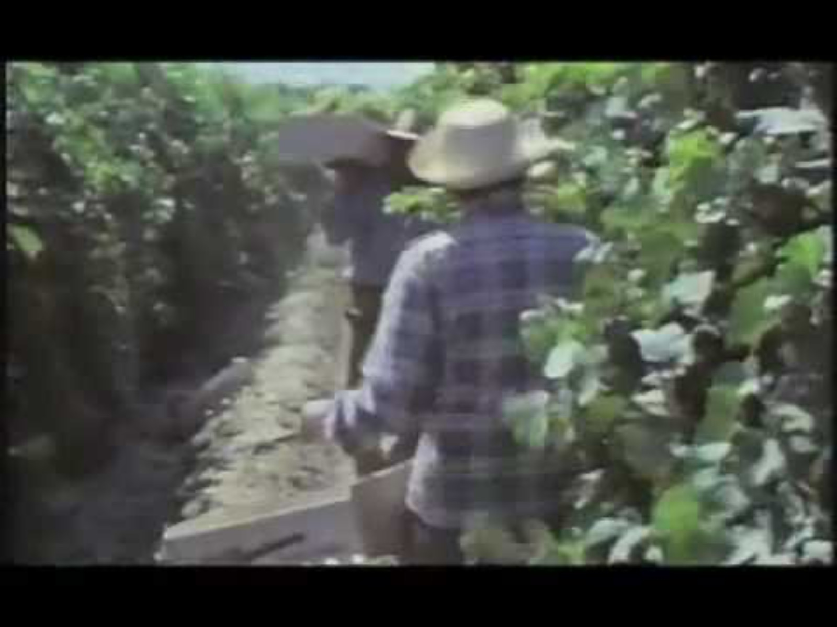
Who is Cesar Chavez?
Notes:
Play the video for the students 6:36
https://youtu.be/NzbL3X68TEI

Slide 5
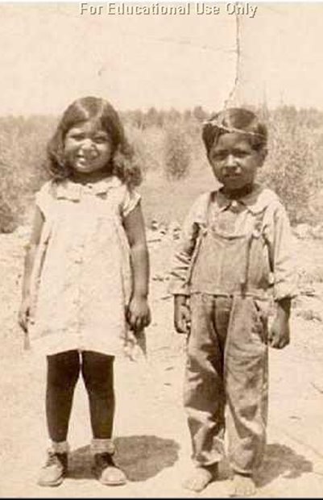
Early Life
Cesar Chavez was born in Yuma, Arizona in 1927.
Cesar's father, Librado and mother, Dorotea were both born in Mexico.
For much of his childhood, Cesar and his family lived on their family farmland with his Abuela and their extended family.
When Cesar was 12 years old, his Abuela died, and the government seized the family property.
This was during the Great Depression era, where many Americans were struggling to get by.

Slide 6
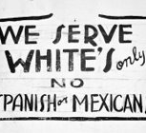
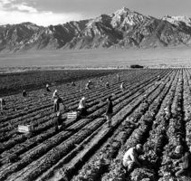
Farm Work
Cesar Chavez's family moved to northern California when he was 12 to find work as migrant farmers.
The family suffered financially which caused them to move around a lot, and Cesar to change schools many times.
Cesar experienced ridicule from his peers due to his family's lack of financial resources, as well as anti-Latino sentiments that were rampant at that time.
Cesar did not have the opportunity to attend high school, as he had to work in the fields to help support his family.

Slide 7

Reflection
Cesar Chavez's family experienced hardship as a result of the Great Depression.
After middle school, Cesar Chavez had to stop his schooling to begin supporting his family as a migrant farmer.
Do you think this still happens today? Where kids must stop going to school so they can work and support their families?

Slide 8
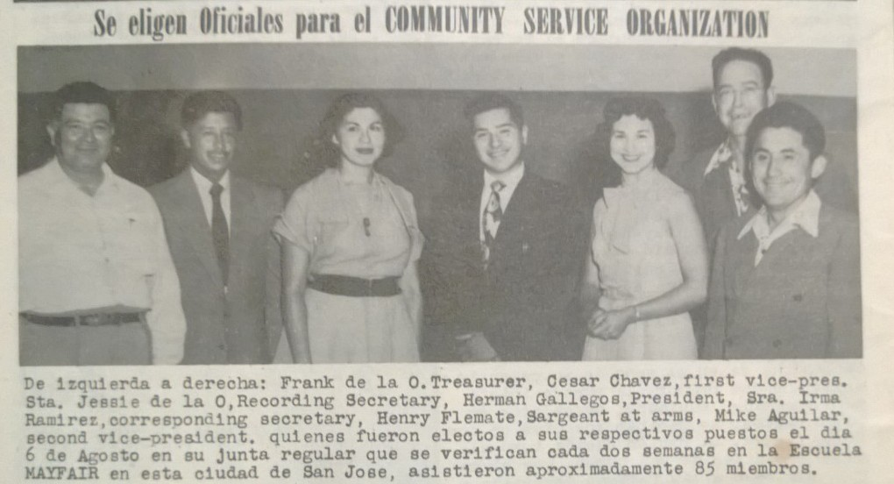
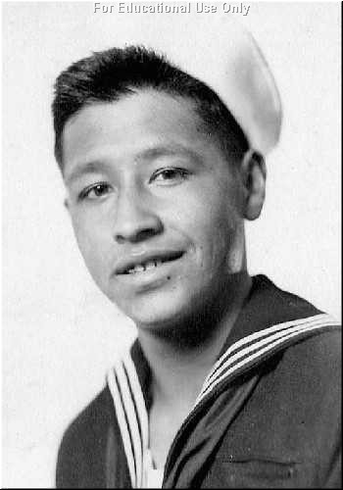
Activism
Cesar Chavez served in the United States Navy from 1946 to 1948.
Upon returning from the Navy, Cesar befriended two social justice activists with whom he worked to create the Community Service Organization.
Cesar worked for the Community Service Organization for 9 years, moving all over California to hear the challenges facing farm workers, and support them in fighting for their rights.

Slide 9
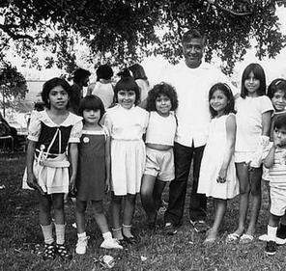
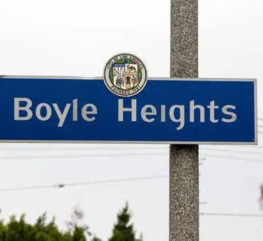
Family Life
Cesar Chavez married Helen Fabola in 1949 and by 1959 they had 8 children together.
Cesar and his family moved from city to city in order to support the farm workers and fight for their rights.
This means, that Cesar's family moved to these California cities over the course of 10 years:
  San Jose
  Salinas
  Fresno
  Brawley
  San Bernadino
  Madera
  Bakersfield
In 1959 Cesar moved his family to the Boyle Heights neighborhood of Los Angeles.

Slide 10
Reflection
Cesar Chavez's family had to move around a lot in order for Cesar to keep up his work supporting farm workers.
Do you know any kids who have had to move around a lot?

Slide 11

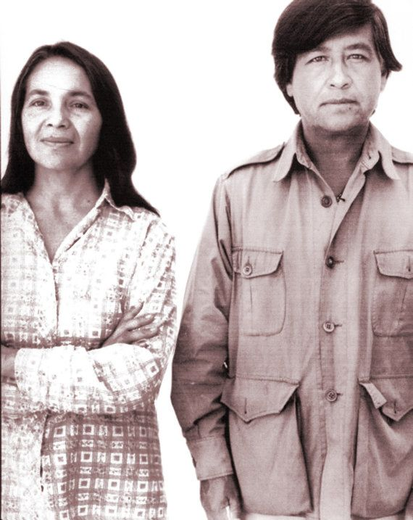
United Farm Workers
In 1962, the National Farm Workers Association (NFWA) was founded – which would later become known as the United Farm Workers (UFW).
César Chávez was elected president, Dolores Huerta and Gilbert Padilla, vice-presidents, and Antonio Orendain, secretary-treasurer.
The union created a flag with a black eagle to represent the darkness of the experience of the farm worker, a white circle to signify hope, and a red background to represent the sacrifice and work the UFW would have to suffer in order to gain justice.
Their official slogan was “Viva La Causa” (Long Live our Cause). César wanted to build a strong union that could fight for justice.

Slide 12
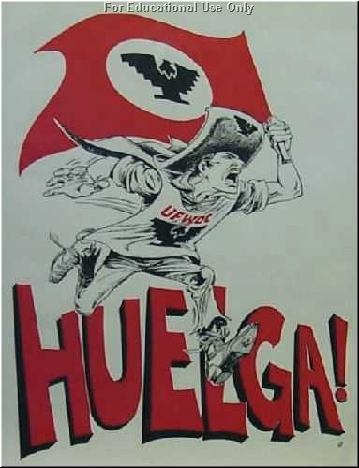
The Delano Grape Strike & Boycott
Together with the Filipino union, Agricultural Workers Organizing Committee, the UFW organized a strike against major farm owners to fight for fair working conditions.
The major farm owners used violence and force to try to stop the strike, but Cesar Chavez had taught the workers the value of nonviolent protests, and the strikers persisted!
The strike was covered by national media outlets and NBC even aired a documentary called "The Harvest of Shame".
Eventually, people across the country began to boycott the grapes being grown in these fields.

Slide 13
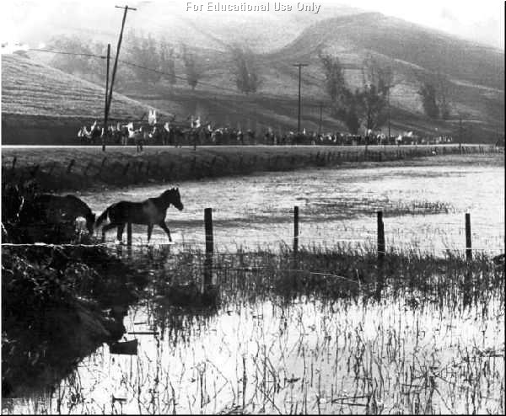
The March
In 1966 Cesar Chavez organized a 340 mile march from Delano to the California Capital of Sacramento to gain support from the public and the government.
By the time the march reached Stockton, there were more than 5,000 people marching.
The organizations eventually agreed to recognize the union and sign a labor contract that would promise better working conditions and higher wages

Slide 14
Reflection
Millions of Americans boycotted grapes as a result of the work done by Cesar Chavez and the union to bring attention to the struggles of the farm workers.
Would you be willing to boycott something you love in order to help other people have a better life?

Slide 15
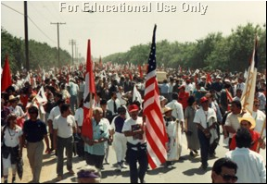
Cesar Chavez Legacy
The Delano Grape Boycott was the first major victory for Cesar Chavez and the United Farm Workers, however Cesar Chavez continued to organize strikes, boycotts, marches and even hunger strikes, in order to draw attention to unfair farming conditions around the country.
Cesar Chavez fought for the rights of others until his death.
Cesar Chavez died on April 23, 1993.
April 29, 1993 in Delano, California, and more than thirty thousand people followed his simple pine casket for three miles. It was their last opportunity to march with a humble man of great strength and vision that had bettered the lives of many people.

Slide 16
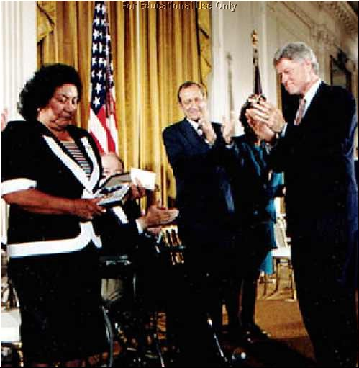
Awards & Recognition
In 1994, President Bill Clinton awarded César E. Chávez the Presidential Medal of Freedom Award, the highest civilian award. His wife, Helen Chávez accepted the honor at the White House in Washington, DC.
In 1990, César was awarded the Aguila Azteca, the highest civilian award by the Mexican government.
The State of California has declared César E. Chávez’s birthday, March 31, a State Holiday to celebrate his life and work – which is why you have March 31st off from school each year!

Slide 17
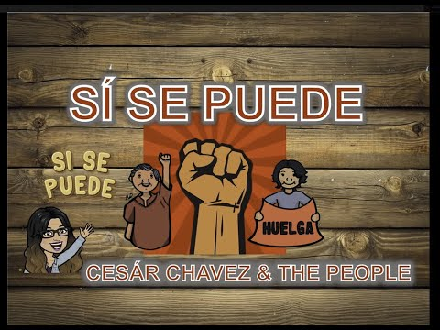
¡Sí Se Puede!
Notes:
Play the video for the students
https://youtu.be/6qWZXn7N7mQ
3:03

Slide 18
Check Out
Would you rather to go the Ocean or the Mountains?
Ocean
Mountains

Slide 19
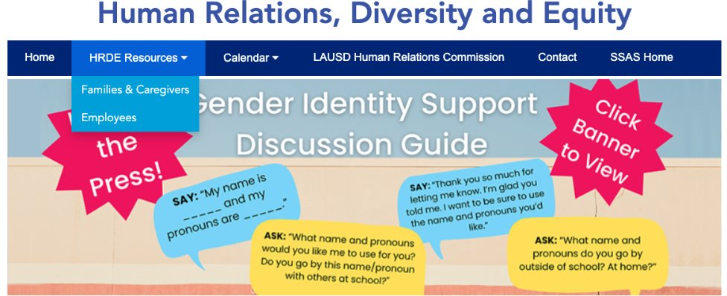
For additional resources, visit us at: https://www.lausd.org/human-relations

Slide 20

Teacher Survey
Notes:
Teacher, please complete the brief feedback survey by scanning the QR code

